Slide 1

Problem Statement: LoRa assisted Intelligent Parking System
Team Members:
Anshika Gupta 19EARCS017
Sumant Kumar 19EARCS755
Vishal Sharma 19EARCS762
Shivani Yadav 19EARCS752
Aditya Shukla 19EARCS007
Under the Guidance of:
Dr. Ashok Kumar Kajla

Slide 2
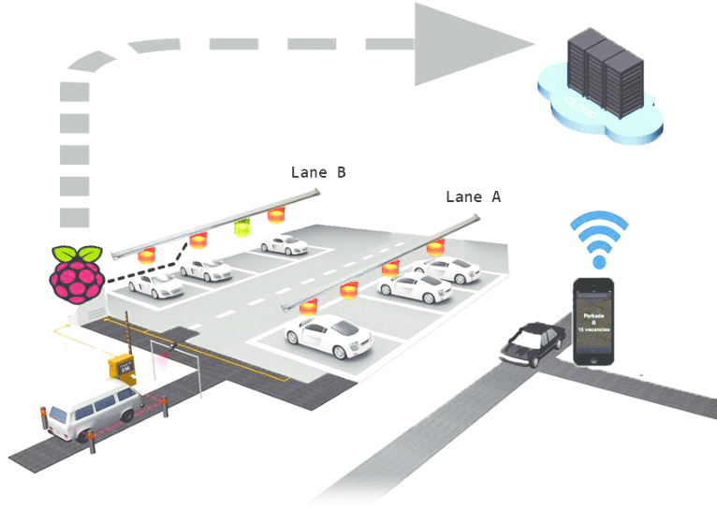
LoRa assisted Intelligent Parking System
Smart Parking’s SmartPark system fully integrates parking, guidance, payment and analytics as well as a host of other complementary services and options. This makes the complete SmartPark solution truly a sum of its parts, and an industry leader in the technology and parking sector.

Slide 3
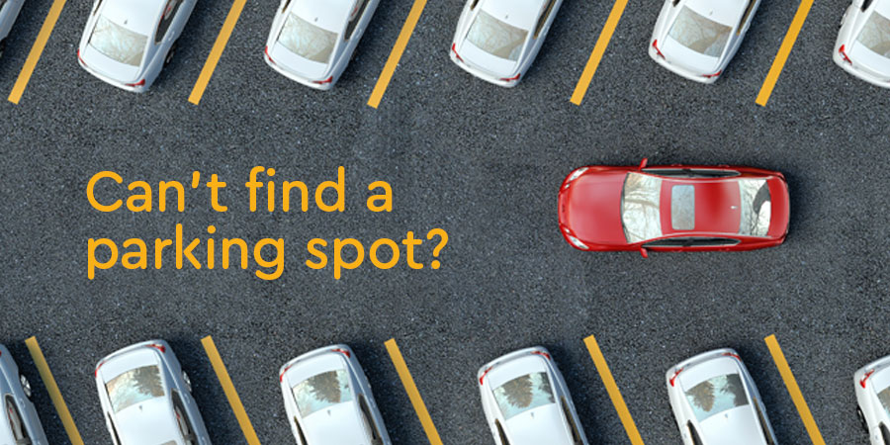
Problem Statement :
In the modern society, there is an ever-increasing number of vehicles. This is leading to problems such as large urban parking lots becoming inefficient, increasing difficulty to find open spaces in busy parking lots, as well as the increasing need to devote larger areas of land for additional parking spaces.

Slide 4

Previous Work:
The Arduino Board or many other different parking methods that have been suggested for transferring data into the cloud. At each parking lot, these WiFi devices have been put, by which we must supply internet connectivity for each WiFi module, this raises the cost.
With the suggested approach, we retain LoRa transmitters and a single receiver that uses WiFi protocol to send data into the cloud in place of Wifi modules at parking lots. For the data to be sent to the cloud, only the receiver must have internet connection. The price is therefore decreased.

Slide 5
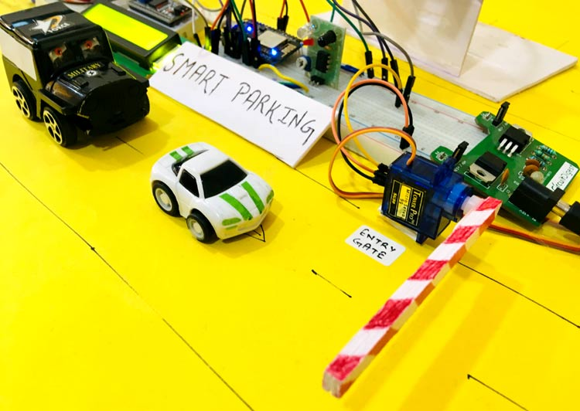
Smart Parking System Process:

Slide 6

Main Objective:
The main objectives of study is to answer the following questions:
Is it fair to increase supply in order to satisfy the rising demand for parking?
Does it have a chance of lasting?
Can a demand, supply, and pricing method based on the market offer a better long-term alternative?

Slide 7
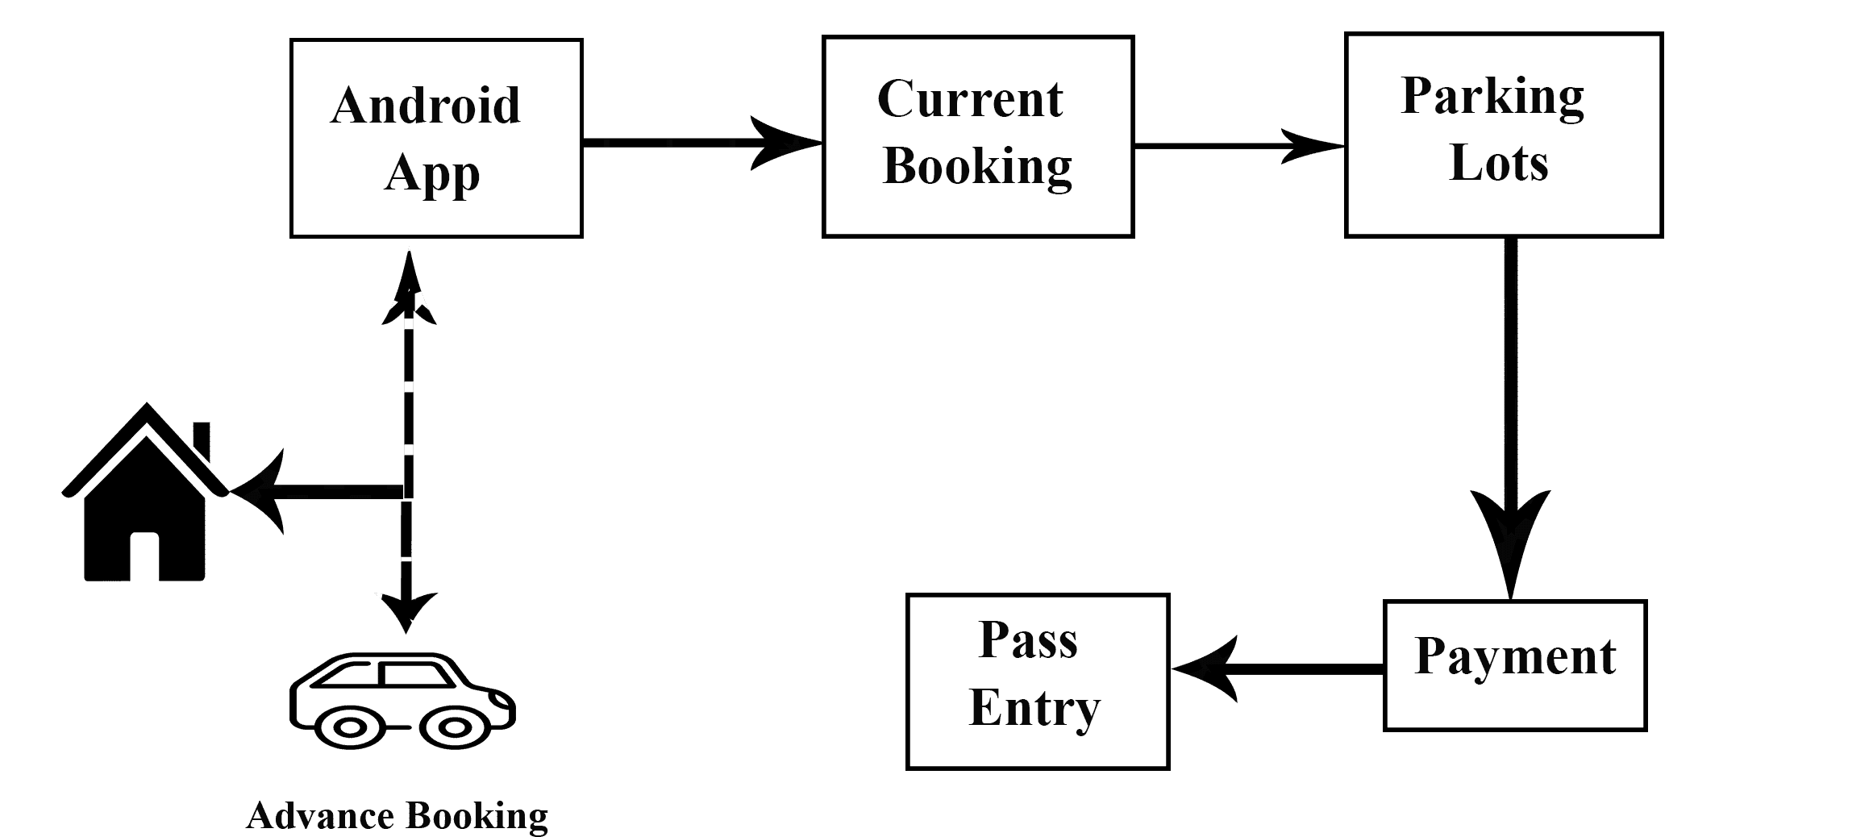
Existing System:

Slide 8
Real time survey :

Slide 9
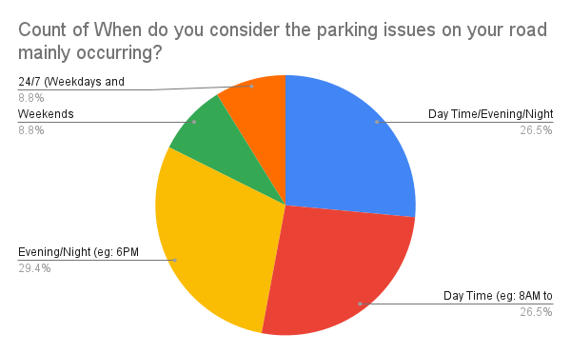

Slide 10
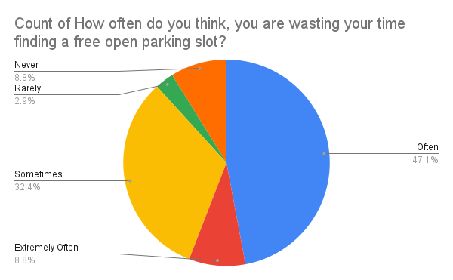

Slide 11
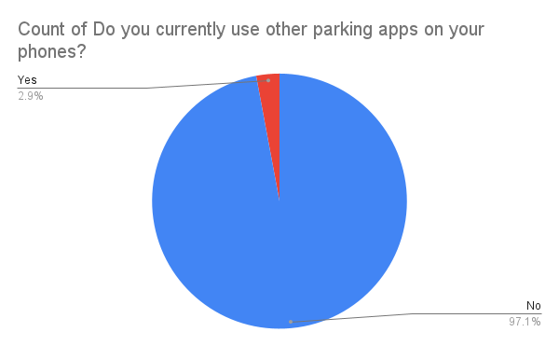

Slide 12


Startups | Park+ | Get My Parking | Secure Parking | Parking Rhino | Park Smart | Park Zap | MyParkings | VersionX | Our Solution
Advance Booking
FASTag
Future Prediction
Monthly Pass
2 Wheelers Parking
Electric Vehicles Charging
Flexible cost

Slide 13
Why LoRa?
Low power consumption for duration and minimal maintenance
High data capacity for managing multiple parking areas
Bi-directional communication with end-to-end encryption to protect your data
Wireless range of up to 3 km (1.86 miles) in urban areas or indoors and 15 km (9.32 miles) in rural areas or outdoors

Slide 14
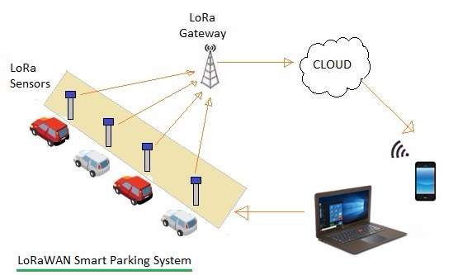
Proposed System:

Slide 15
Proposed Solution:
We will make a platform where the user will get all the information related to availability of parking slots.
A picture of parking infrastructure in real time
Security and transparency in parking fees and service delivery
Managing and obtaining parking spots with flexibility
Parking usage data analytics

Slide 16
User ID removed
Start Application
Features
Real time data Display
Booking Slot
Advance Booking
Vehicle Category
Make payment
Slot Allotted
Cloud Database
User ID generated
Time Started
Time out

Slide 17
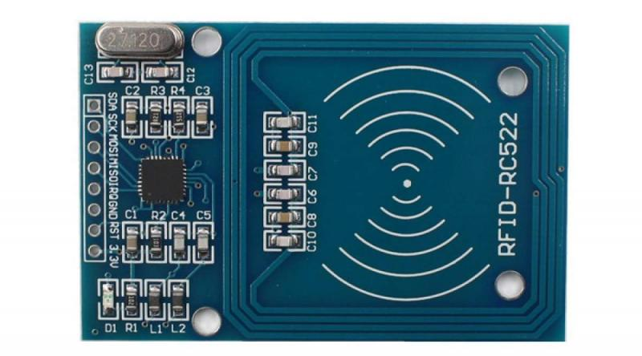
How is RFID used in Parking System?
Each user is given a credential or badge that gives him access to the facility, and an RFID reader is installed at the points of entry and exit of the parking lot.

Slide 18
Working:
The project demonstrates the use of an Arduino Uno to construct an RFID-based automobile parking system in which only authorised individuals with active RFID cards are allowed to park.
The authorised individual with an RFID tag may enter once the circuit is turned ON.
A distinct card number is transmitted to the microcontroller when the ID card is recognised by the reader.
If the card number matches one that has been recorded in the microcontroller or database, the microcontroller will let the automobile to park in the restricted area. If not suited, the gate won't open to let a car park.

Slide 19
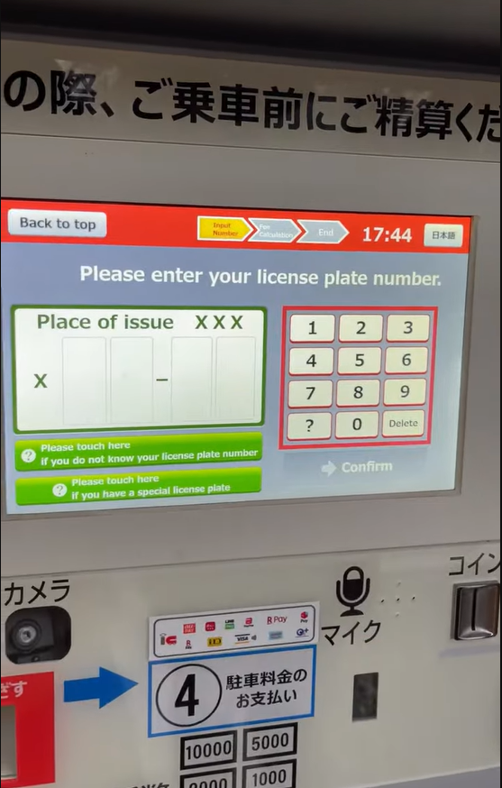
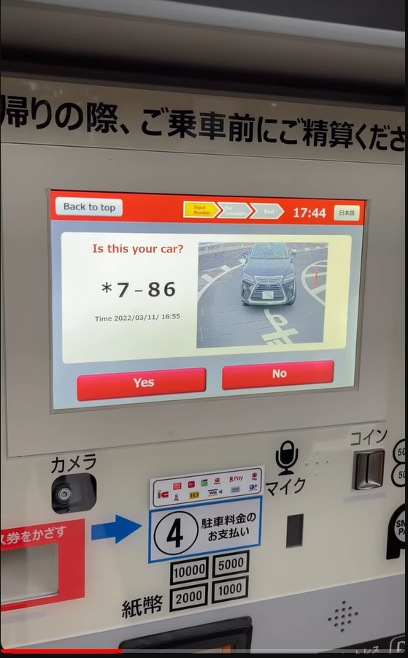
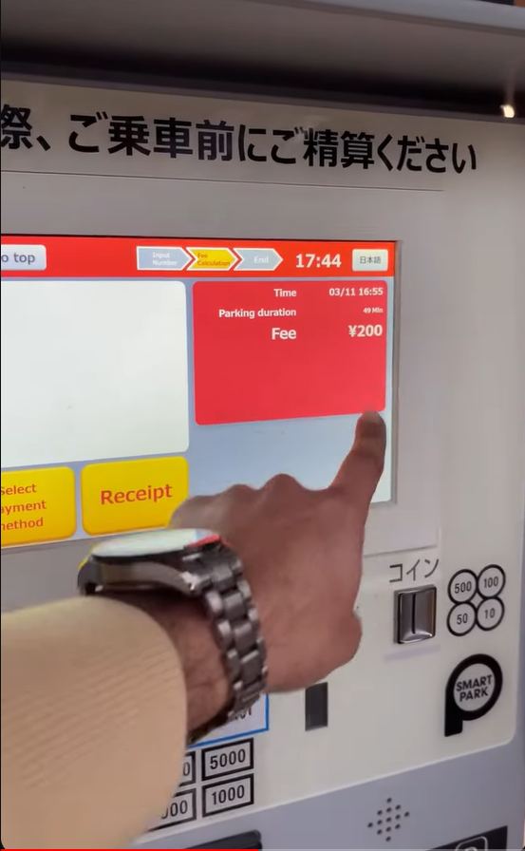
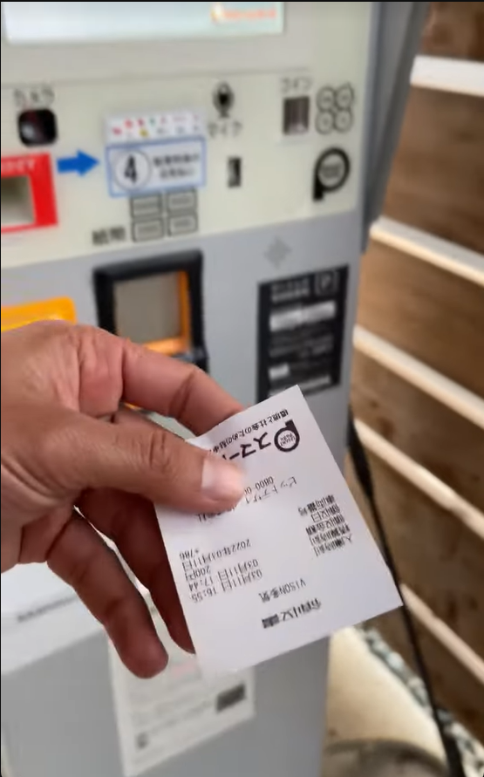
Step 1:
Enter Your Car Number
Step 2: System detect Car Number from Car
Step 3: Select time and according Time your Payment Amount Generate
Step :4 After your Payment Your Receipt Generated

Slide 20
Advantage & Application
This project includes the implementation of an IOT based car parking system that can do away with the difficulty of manual parking system operation.
This method can help with cost reduction, productivity improvement, and time savings.

Slide 21
Future Work:
The proposed work mainly focuses on the parking problem around a specific state. work can be extended in the future by using different IOT techniques.

Slide 22
Conclusion:
This proposal uses an RFID-based car parking system, which might replace the costly manual operation of the parking system.
By increasing production, decreasing costs, and saving time, this approach can be beneficial.

Slide 23
Thank you

